Slide 1


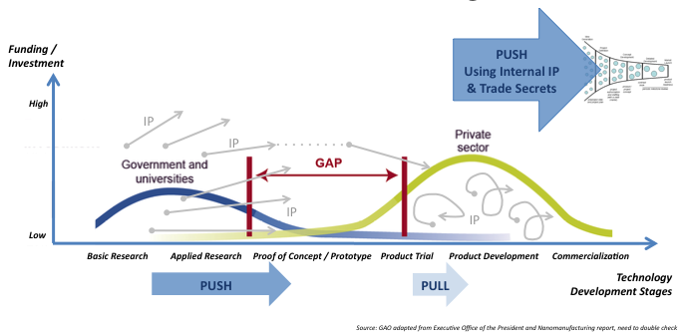
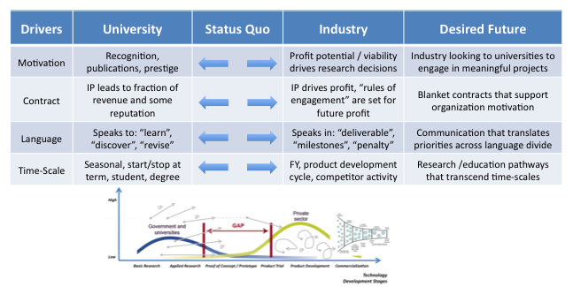
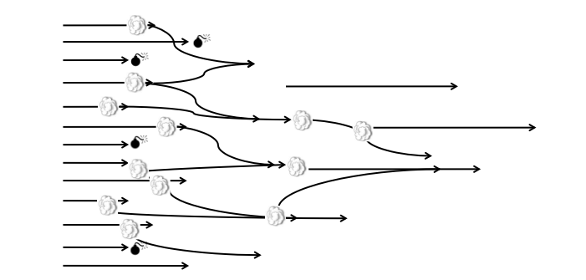
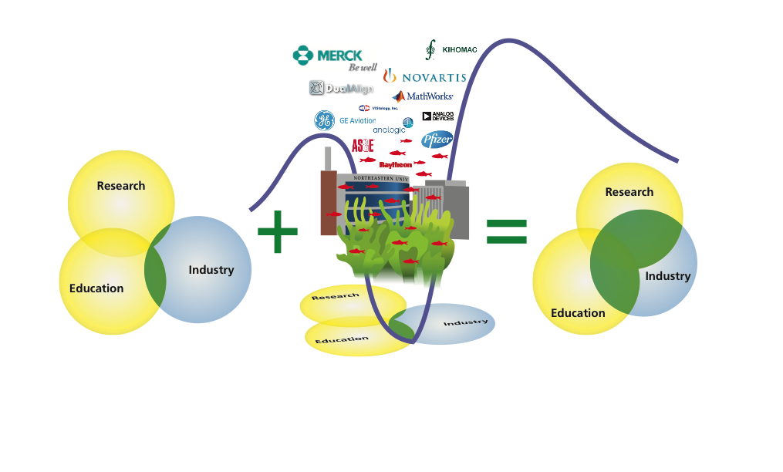



Rogers
MAGNETICALLY TEXTURED COMPOSITES FOR THERMAL MANAGEMENT
Sara Wadia-Fascetti¹ (PhD Candidate in Civil Engineering), Amdanda Cornwall¹, Shawn Williams²
¹Northeastern University and ²Rogers Corporation
Background to Collaboration:
This slide/poster size is 40.97x23.04 (16:9 aspect ratio)
Minimum font: 28pt (this may seem large, but at this poster size it’s not)
Recommended font Types: Calibri, Arial, Times New Roman
When possible use 32pt or higher!
This is only a template. All content may be modified
If you are creating your e-poster on a PC, please make sure to save your formulas as an image and embed it into your presentation or they will change on our Macs.
Research Question with Partner:
Partner Gaps and Need to Address:
Layout should be landscape – 1 slide max. Additional materials can be available in hard copy on the table.
Less is more – this is an elevator presentation – not your typical research presentation. This is a high level conversation – 10k feet… or higher!
Embedded videos can only be displayed in .mov, .mp4, .mpeg. Note: Upload your video file along with your PowerPoint file.
Save all mathematical formulas and equations to images (.jpg, .png) when embedding or upload your excel file along with your PowerPoint file.
Save PowerPoint as .pptx to include all your embedded images and videos.
Describe your Experience:
The audience is highly interdisciplinary, and it is important to speak / present broadly and across many discplines.
Include graphics. Focus on fewer big picture graphics and avoid many different research tables. If you wish, you can bring additional handouts available at the tables.
Describe Impact and Future Next Steps:
Include graphics. Focus on fewer big picture graphics and avoid many different research tables. If you wish, you can bring additional handouts available at the tables.
Experiential PhD Expo: Partnerships Benefiting Research, Maximizing Impact and Broadening Careers

